Slide 1
Client/server applications in C#
By Caleb Ellis

Slide 2
The idea
At first, I set my sights on developing a simple TCP/IP Chat Client and server based off of IMS (Instant Messaging Services).
What I wanted was a interface where someone could create a server and clients could easily connect to that server.
But then I realized that the project was much more than, I could adapt/modularize the server code to make it any type of server that I wanted. In the end it worked out more like a platform for managing different servers. This was I could develop different types of servers and use the server application to start/stop and configure them.
The project is still in a primordial state, therefore server applications are executed by plugging what could be regarded as server modules. I am in the process of optimizing it.

Slide 3
The project
The project in its current state utilizes the following technologies:
C#.net
WPF (Windows Presentation Foundation)
Python
Socket Programming
The Project is current floating around 1500 lines of code but as I said, I still have to do some optimizations.

Slide 4
C#/WPF
I used C# for the following components of the project:
Server Core
Original Client GUI (Chat)
Original Client Command line (Chat)
I used WPF for the follow component of the project:
Original Client GUI (Chat)

Slide 5
PYTHOn
I used Python for the following components of the project:
File Client application
File Server Module

Slide 6
How the server works
The Server is built on a command system that can be extended. The start command is used to start new servers and is the part that allows different types of applications/code to be invoked based off the server.
The server waits for a connection and when one is established, it waits until the connection to send something. The server parse the values and sends back based off the specification of the application

Slide 7
Sockets: server side
Sockets are what are used to programmatically send data between software and ultimately between two computers. A socket is represented by an IP and a port number.
Example Socket: 192.168.1.1:8080
We start by creating a socket that will act as a listener. This listener is what waits for incoming connections.
To create the listener you need the following:
The servers IP address
The port number the server will be using
these both represent the Local Endpoint which is used to determine if the socket is a listener or a handler.

Slide 8
Sockets: server side (cont.)
After the listener is created we need to bind the listener to the endpoint.
Once the listener has been binded, we can simply start listening for inbound connections by initializing it with a backlog.
The backlog is what defines how many connections the server can maintain at any given time.
In order to parse the data that a client sends, we create a new socket that is usually named handler. The handler is the result of a listen accepting a connection.
From there the handler maintains the connection between the Remote Endpoint.
We wrap this action of receiving in an infinite loop so that the client can continually send data.

Slide 9
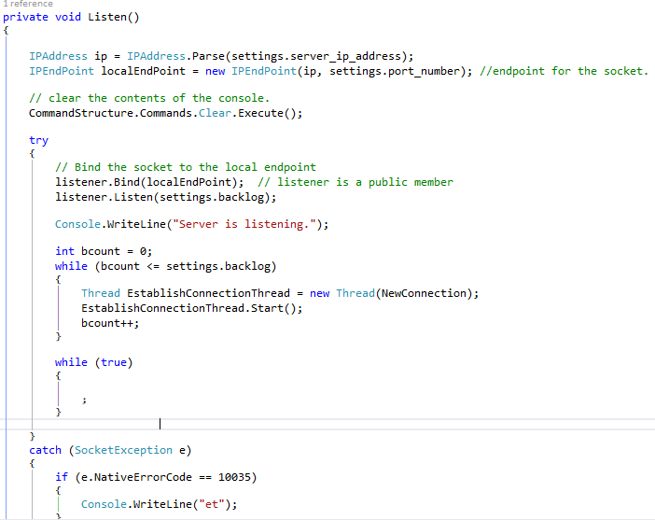
Server: Listen Function
Create and bind the socket and then start listening, starting threads (based on the value for the back log) until they are all created and then start an infinite loop to stop the mean thread.

Slide 10
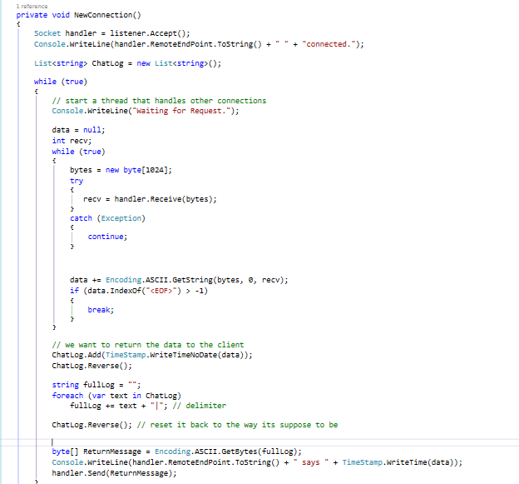
Server: New Connection Function
Accepts a new connection and then waits
To receive something from the connection.
It then parses the data, writes to the server
Log/console and then sends it back to the
User with a time stamp.

Slide 11
Socket: Client Side
The Client socket programming is pretty simple in comparison to the server.
We start of by defining a socket that is usually named “sender”, this socket is what connects to a remote end point and is used to send data.
This time, we need to establish a connection to a remote endpoint so instead we use the servers IP address and port number that it is using. This time, were not binding the socket, but rather connecting to the remote end point.
After connecting, we can send data to the server and wait for a reply. Once we receive a reply we can parse the data that it returned and do what we need for it.

Slide 12
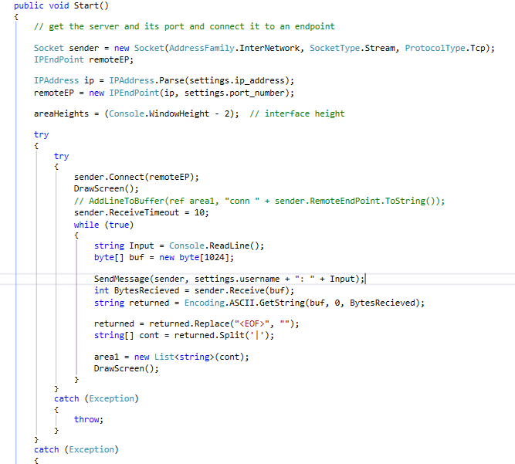
Client: Start function
Create the socket and endpoint. The we connect to the remote endpoint. Once we have sent and received data, we parse it and then draw it on the screen.

Slide 13
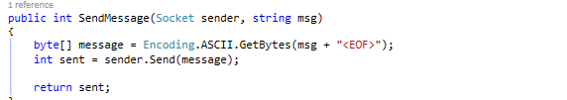
Client: Send message
Sends a message to a remote endpoint and returns the number of bytes that are being sent.

Slide 14
Threading
Multithreading is the act of a program using multiple asynchronous during application execution. Essentially this means that we can call same or different functions at the same time.
I used multithreading in this application so that the server can maintain multiple new connections.

Slide 15
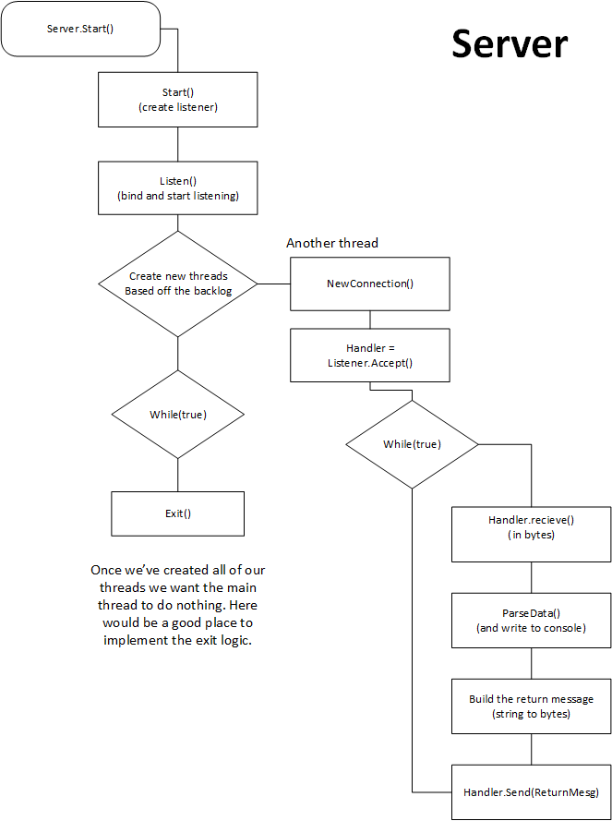
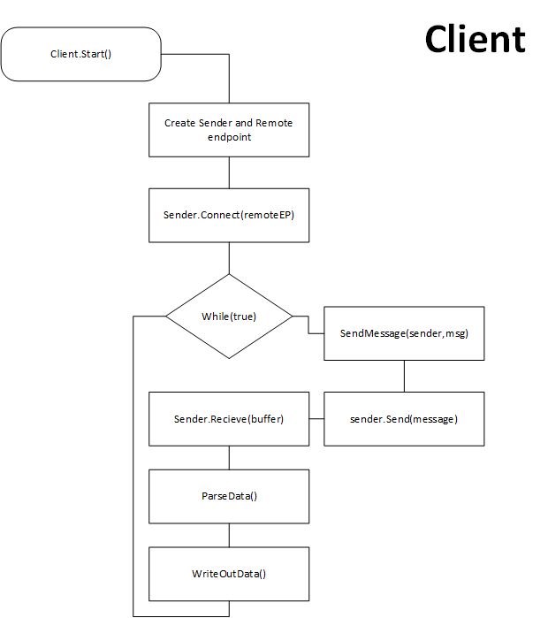

Slide 16
Client/server operations

Slide 17
modularity

Slide 18
Command system

Slide 19
Server commands

Slide 20
Example: Chat client/server

Slide 21
What went wrong with the chat client

Slide 22
Example: file Client/Server

Slide 23
What I learned from the project

Slide 24
What’s good

Slide 25
What I could of done better

Slide 26
Other things that I’ve got out of this project

Slide 27
That’s it

